Slide 1
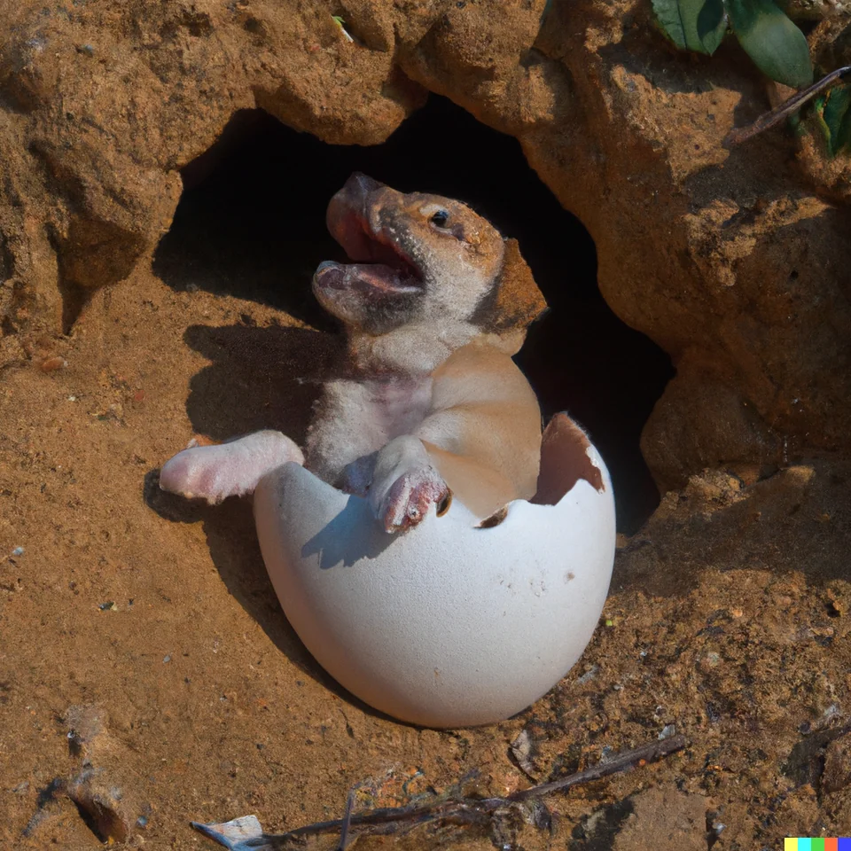
Defining and Using Classes
Lecture 2
CS61B, Fall 2023 @ UC Berkeley
Slides credit: Josh Hug
Notes:
Image from: https://www.reddit.com/r/dalle2/comments/xmfc4l/a_dog_hatching_from_its_egg/

Slide 2
Defining and Instantiating Classes
Classes in Java
Defining and Instantiating Classes
Class Terminology
Static vs. Instance Members
Practice Question
Helper Methods
Managing Complexity with Helper Methods
Goal: Larger Than Four Neighbors
Coding Without Helper Methods
Coding With Helper Methods
Lecture 2, CS61B, Fall 2023

Slide 3
Coding Demo: Dog class
Dog.java
public class Dog {
public static void makeNoise() {
System.out.println("Bark!");
}
}
Error: Main method not found in class Dog

Slide 4
Coding Demo: Dog class
Dog.java
public class Dog {
public static void makeNoise() {
System.out.println("Bark!");
}
public static void main(String[] args) {
makeNoise();
}
}
Bark!

Slide 5
Coding Demo: Dog class
Dog.java
DogLauncher.java
public class Dog {
public static void makeNoise() {
System.out.println("Bark!");
}
public static void main(String[] args) {
makeNoise();
}
}
public class DogLauncher {
}
Bark!

Slide 6
Coding Demo: Dog class
Dog.java
DogLauncher.java
public class Dog {
public static void makeNoise() {
System.out.println("Bark!");
}
}
public class DogLauncher {
public static void main(String[] args) {
Dog.makeNoise();
}
}
Bark!

Slide 7
Dog
As we saw last time:
Every method (a.k.a. function) is associated with some class.
To run a class, we must define a main method.
Not all classes have a main method!
Unlike python, there’s no need to import if the two files are in the same project.
public class Dog {
public static void makeNoise() {
System.out.println("Bark!");
}
}
Can’t be run directly, since there is no main method.
public class DogLauncher {
public static void main(String[] args) {
Dog.makeNoise();
}
}
Calls a method from another class. Can think of this as a class that tests out the Dog class.

Slide 8
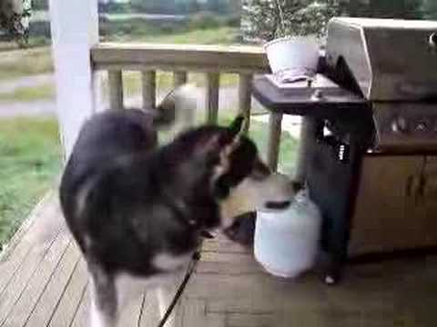

Object Instantiation
Not all dogs are equal!
Notes:
12m30s without announcements or questions

Slide 9
A Not So Good Approach
We could create a separate class for every single dog out there, but this is going to get redundant in a hurry.
public class MayaTheDog {
public static void makeNoise() {
System.out.println("aroooooooooo!");
}
}
public class YapsterTheDog {
public static void makeNoise() {
System.out.println("awawawwwawwa awawaw");
}
}

Slide 10
Object Instantiation
Classes can contain not just functions (a.k.a. methods), but also data.
For example, we might add a size variable to each Dog.
Classes can be instantiated as objects.
We’ll create a single Dog class, and then create instances of this Dog.
The class provides a blueprint that all Dog objects will follow.
For the example above, all Dog objects will have a size.
Let’s try this out.
These instances are also called ‘objects’

Slide 11
Coding Demo: Dog class
Dog.java
DogLauncher.java
public class Dog {
public static void makeNoise() {
System.out.println("Bark!");
}
}
public class DogLauncher {
public static void main(String[] args) {
Dog.makeNoise();
}
}

Slide 12
Coding Demo: Dog class
Dog.java
DogLauncher.java
public class Dog {
int weightInPounds;
public static void makeNoise() {
System.out.println("Bark!");
}
}
public class DogLauncher {
public static void main(String[] args) {
Dog.makeNoise();
}
}

Slide 13
Coding Demo: Dog class
Dog.java
DogLauncher.java
public class Dog {
int weightInPounds;
public static void makeNoise() {
if (weightInPounds < 10) {
System.out.println("yip!");
} else if (weightInPounds < 30) {
System.out.println("bark.");
} else {
System.out.println("woooooof!");
}
}
}
public class DogLauncher {
public static void main(String[] args) {
Dog.makeNoise();
}
}
Error: Non-static variable weightInPounds cannot be referenced from a static context.

Slide 14
Coding Demo: Dog class
Dog.java
DogLauncher.java
public class Dog {
int weightInPounds;
public void makeNoise() {
if (weightInPounds < 10) {
System.out.println("yip!");
} else if (weightInPounds < 30) {
System.out.println("bark.");
} else {
System.out.println("woooooof!");
}
}
}
public class DogLauncher {
public static void main(String[] args) {
Dog.makeNoise();
}
}
Error: Non-static method makeNoise cannot be referenced from a static context.

Slide 15
Coding Demo: Dog class
Dog.java
DogLauncher.java
public class Dog {
int weightInPounds;
public void makeNoise() {
if (weightInPounds < 10) {
System.out.println("yip!");
} else if (weightInPounds < 30) {
System.out.println("bark.");
} else {
System.out.println("woooooof!");
}
}
}
public class DogLauncher {
public static void main(String[] args) {
Dog d = new Dog();
d.weightInPounds = 25;
d.makeNoise();
}
}
bark.

Slide 16
Coding Demo: Dog class
Dog.java
DogLauncher.java
public class Dog {
int weightInPounds;
public void makeNoise() {
if (weightInPounds < 10) {
System.out.println("yip!");
} else if (weightInPounds < 30) {
System.out.println("bark.");
} else {
System.out.println("woooooof!");
}
}
}
public class DogLauncher {
public static void main(String[] args) {
Dog d = new Dog();
d.weightInPounds = 51;
d.makeNoise();
}
}
woooooof!

Slide 17
Coding Demo: Dog class
Dog.java
DogLauncher.java
public class Dog {
int weightInPounds;
public Dog(int w) {
weightInPounds = w;
}
public void makeNoise() {
if (weightInPounds < 10) {
System.out.println("yip!");
} else if (weightInPounds < 30) {
System.out.println("bark.");
} else {
System.out.println("woooooof!");
}
}
}
public class DogLauncher {
public static void main(String[] args) {
Dog d = new Dog(51);
d.makeNoise();
}
}
woooooof!

Slide 18
Our Dog Class
public class Dog {
public int weightInPounds;
public Dog(int startingWeight) {
weightInPounds = startingWeight;
}
public void makeNoise() {
if (weightInPounds < 10) {
System.out.println("yipyipyip!");
} else if (weightInPounds < 30) {
System.out.println("bark. bark.");
} else {
System.out.println("woof!");
}
}
}

Slide 19
Java vs. Python Classes
public class Dog {
public int weightInPounds;
public Dog(int startingWeight) {
weightInPounds = startingWeight;
}
public void makeNoise() {
if (weightInPounds < 10) {
System.out.println("yipyipyip!");
} else if (weightInPounds < 30) {
System.out.println("bark. bark.");
} else {
System.out.println("woof!");
}
}
}
For those of you who know Python, the equivalent code is given below.
class Dog():
def __init__(self, startingWeight):
self.weightInPounds = startingWeight
def makeNoise(self):
if self.weightInPounds < 10:
print "yipyipyip!"
elif self.weightInPounds < 30:
print "bark. Bark."
else:
print "woof!"

Slide 20
Class Terminology
Classes in Java
Defining and Instantiating Classes
Class Terminology
Static vs. Instance Members
Practice Question
Helper Methods
Managing Complexity with Helper Methods
Goal: Larger Than Four Neighbors
Coding Without Helper Methods
Coding With Helper Methods
Lecture 2, CS61B, Fall 2023

Slide 21
Defining a Typical Class (Terminology)
public class Dog {
public int weightInPounds;
public Dog(int startingWeight) {
weightInPounds = startingWeight;
}
public void makeNoise() {
if (weightInPounds < 10) {
System.out.println("yipyipyip!");
} else if (weightInPounds < 30) {
System.out.println("bark. bark.");
} else {
System.out.println("woof!");
}
}
}
Instance variable. Can have as many of these as you want.
Constructor (similar to a method, but not a method). Determines how to instantiate the class.
Non-static method, a.k.a. Instance Method. Idea: If the method is going to be invoked by an instance of the class (as in the next slide), then it should be non-static.
Roughly speaking: If the method needs to use “my instance variables”, the method must be non-static.

Slide 22
Object Instantiation
Classes can contain not just functions (a.k.a. methods), but also data.
For example, we might add a size variable to each Dog.
Classes can be instantiated as objects.
We’ll create a single Dog class, and then create instances of this Dog.
The class provides a blueprint that all Dog objects will follow.
For the example above, all Dog objects will have a size.
Cannot add new instance variables to a Dog. They must ALL obey the blueprint exactly.
These instances are also called ‘objects’
public class DogLauncher {
public static void main(String[] args) {
Dog hugeDog = new Dog(150);
hugeDog.weightInPounds = 5; // guaranteed to exist
hugeDog.name = "frank"; // syntax error!
}
}

Slide 23
Instantiating a Class and Terminology
public class DogLauncher {
public static void main(String[] args) {
Dog smallDog;
new Dog(20);
smallDog = new Dog(5);
Dog hugeDog = new Dog(150);
smallDog.makeNoise();
hugeDog.makeNoise();
}
}
Declaration of a Dog variable.
Instantiation of the Dog class as a Dog Object.
Instantiation and Assignment.
Declaration, Instantiation and Assignment.
Invocation of the 150 lb Dog’s makeNoise method.
The dot notation means that we want to use a method or variable belonging to hugeDog, or more succinctly, a member of hugeDog.

Slide 24
Arrays of Objects
To create an array of objects:
First use the new keyword to create the array.
Then use new again for each object that you want to put in the array.
Example:
After code runs:
Dog[] dogs = new Dog[2];
dogs[0] = new Dog(8);
dogs[1] = new Dog(20);
dogs[0].makeNoise();
Creates an array of Dogs of size 2.
Yipping occurs.
dogs =
Dog of size 8 | Dog of size 20
0
1

Slide 25
Static vs. Instance Members
Classes in Java
Defining and Instantiating Classes
Class Terminology
Static vs. Instance Members
Practice Question
Helper Methods
Managing Complexity with Helper Methods
Goal: Larger Than Four Neighbors
Coding Without Helper Methods
Coding With Helper Methods
Lecture 2, CS61B, Fall 2023

Slide 26
Static vs. Non-Static
Key differences between static and non-static (a.k.a. instance) methods:
Static methods are invoked using the class name, e.g. Dog.makeNoise();
Instance methods are invoked using an instance name, e.g. maya.makeNoise();
Static methods can’t access “my” instance variables, because there is no “me”.
Non-static
Static
public void makeNoise() {
if (weightInPounds < 10) {
System.out.println("yipyipyip!");
} else if (weightInPounds < 30) {
System.out.println("bark. bark.");
} else { System.out.println("woof!"); }
}
public static void makeNoise() {
System.out.println("Bark!");
}
This method cannot access weightInPounds!
Dog maya = new Dog(100);
maya.makeNoise();
Invocation:
Dog.makeNoise();
Invocation:

Slide 27
Why Static Methods?
Some classes are never instantiated. For example, Math.
x = Math.round(5.6);
Sometimes, classes may have a mix of static and non-static methods, e.g.
Much nicer than:
Math m = new Math();
x = m.round(x);
public static Dog maxDog(Dog d1, Dog d2) {
if (d1.weightInPounds > d2.weightInPounds) {
return d1;
}
return d2;
}

Slide 28
Coding Demo: maxDog
Dog.java
DogLauncher.java
public class Dog {
int weight;
public Dog(int w) { ... }
public void makeNoise() { ... }
}
public class DogLauncher {
public static void main(String[] args) {
Dog d = new Dog(15);
d.makeNoise();
}
}

Slide 29
Coding Demo: maxDog
Dog.java
DogLauncher.java
public class Dog {
int weight;
public Dog(int w) { ... }
public void makeNoise() { ... }
}
public class DogLauncher {
public static void main(String[] args) {
Dog d = new Dog(15);
Dog d2 = new Dog(100);
Dog bigger = Dog.maxDog(d, d2);
bigger.makeNoise();
}
}

Slide 30
Coding Demo: maxDog
Dog.java
DogLauncher.java
public class Dog {
int weight;
public Dog(int w) { ... }
public void makeNoise() { ... }
public static Dog maxDog(Dog d1, Dog d2) {
if (d1.weight > d2.weight) {
return d1;
}
return d2;
}
}
public class DogLauncher {
public static void main(String[] args) {
Dog d = new Dog(15);
Dog d2 = new Dog(100);
Dog bigger = Dog.maxDog(d, d2);
bigger.makeNoise();
}
}

Slide 31
Coding Demo: maxDog
Dog.java
DogLauncher.java
public class Dog {
int weight;
public Dog(int w) { ... }
public void makeNoise() { ... }
public static Dog maxDog(Dog d1, Dog d2) {
if (d1.weight > d2.weight) {
return d1;
}
return d2;
}
public Dog maxDog(Dog d2) {
if (weight > d2.weight) {
return this;
}
return d2;
}
}
public class DogLauncher {
public static void main(String[] args) {
Dog d = new Dog(15);
Dog d2 = new Dog(100);
Dog bigger = Dog.maxDog(d, d2);
bigger.makeNoise();
}
}

Slide 32
Coding Demo: maxDog
Dog.java
DogLauncher.java
public class Dog {
int weight;
public Dog(int w) { ... }
public void makeNoise() { ... }
public static Dog maxDog(Dog d1, Dog d2) {
if (d1.weight > d2.weight) {
return d1;
}
return d2;
}
public Dog maxDog(Dog d2) {
if (weight > d2.weight) {
return this;
}
return d2;
}
}
public class DogLauncher {
public static void main(String[] args) {
Dog d = new Dog(15);
Dog d2 = new Dog(100);
Dog bigger = Dog.maxDog(d, d2);
bigger.makeNoise();
bigger = d.maxDog(d2);
bigger.makeNoise();
}
}

Slide 33
Coding Demo: maxDog
Dog.java
DogLauncher.java
public class Dog {
int weight;
public Dog(int w) { ... }
public void makeNoise() { ... }
public static String binomen = "canis";
public static Dog maxDog(Dog d1, Dog d2) {
if (d1.weight > d2.weight) {
return d1;
}
return d2;
}
public Dog maxDog(Dog d2) {
if (weight > d2.weight) {
return this;
}
return d2;
}
}
public class DogLauncher {
public static void main(String[] args) {
Dog d = new Dog(15);
Dog d2 = new Dog(100);
Dog bigger = Dog.maxDog(d, d2);
bigger.makeNoise();
bigger = d.maxDog(d2);
bigger.makeNoise();
System.out.println(Dog.binomen);
}
}

Slide 34
Static Variables (are Dangerous)
Classes can also have static variables.
You should always access class variables using the class name, not an instance name.
Bad coding style to do something like maya.binomen.
Even worse to do something like maya.binomen = “Vulpes vulpes”
Warning: Strongly recommended to avoid static variables whose values change.
Leads to complicated code: Becomes hard to mentally keep track of which parts of your program read and write from/to the static variable. For more read this.
public class Dog {
public int weightInPounds;
public static String binomen = "Canis familiaris";
public Dog(int startingWeight) {
weightInPounds = startingWeight;
}
...
}
Never changes. It’s a constant.

Slide 35
Static vs. Non-Static
A class may have a mix of static and non-static members.
A variable or method defined in a class is also called a member of that class.
Static members are accessed using class name, e.g. Dog.binomen.
Non-static members cannot be invoked using class name: Dog.makeNoise()
Static methods must access instance variables via a specific instance, e.g. d1.
public class Dog {
public int weightInPounds;
public static String binomen = "Canis familiaris";
public Dog(int startingWeight) {
weightInPounds = startingWeight;
}
public static Dog maxDog(Dog d1, Dog d2) {
if (d1.weightInPounds > d2.weightInPounds)
{ return d1; }
return d2;
}
...
...
public void makeNoise() {
if (weightInPounds < 10) {
System.out.println("yipyipyip!");
} else if (weightInPounds < 30) {
System.out.println("bark. bark.");
} else {
System.out.println("woof!");
}
}
}

Slide 36
Practice Question
Classes in Java
Defining and Instantiating Classes
Class Terminology
Static vs. Instance Members
Practice Question
Helper Methods
Managing Complexity with Helper Methods
Goal: Larger Than Four Neighbors
Coding Without Helper Methods
Coding With Helper Methods
Lecture 2, CS61B, Fall 2023

Slide 37
Question: Will this program compile? If so, what will it print?
public class DogLoop {
public static void main(String[] args) {
Dog smallDog = new Dog(5);
Dog mediumDog = new Dog(25);
Dog hugeDog = new Dog(150);
Dog[] manyDogs = new Dog[4];
manyDogs[0] = smallDog;
manyDogs[1] = hugeDog;
manyDogs[2] = new Dog(130);
int i = 0;
while (i < manyDogs.length) {
Dog.maxDog(manyDogs[i], mediumDog).makeNoise();
i = i + 1;
}
}
}
< 10: yip
< 30: bark
>=30: woof
Notes:
26 minutes not including questions or announcements

Slide 38
Answer to Question
Won’t go over in live lecture.
Use the Java visualizer to see the solution here: http://goo.gl/HLzN6s
Video solution: https://www.youtube.com/watch?v=Osuy8UEH03M

Slide 39
Managing Complexity with Helper Methods
Classes in Java
Defining and Instantiating Classes
Class Terminology
Static vs. Instance Members
Practice Question
Helper Methods
Managing Complexity with Helper Methods
Goal: Larger Than Four Neighbors
Coding Without Helper Methods
Coding With Helper Methods
Lecture 2, CS61B, Fall 2023

Slide 40
Managing Complexity with Classes and Static Methods
Some obvious questions arise:
Why does Java force us to use classes?
Why have static methods at all?
The reason: To take choices away from the programmer.
Fewer choices means fewer ways to do things.
Example: Declaring a method static means you can’t use any instance variables in that method.
Fewer ways to do things often means less complexity.

Slide 41
Managing Complexity More Generally
In my opinion, a good foundational computer science course should primarily teach you to properly manage complexity.
This philosophy drives nearly all aspects of this 61B’s design.
Let’s cover one important idea that you’ll want to be using all throughout the course: helper methods.
Using helper methods lets you formalize the decomposition of large problems into small ones.
By focusing mental effort on a single task, there’s less room to make mistakes.

Slide 42
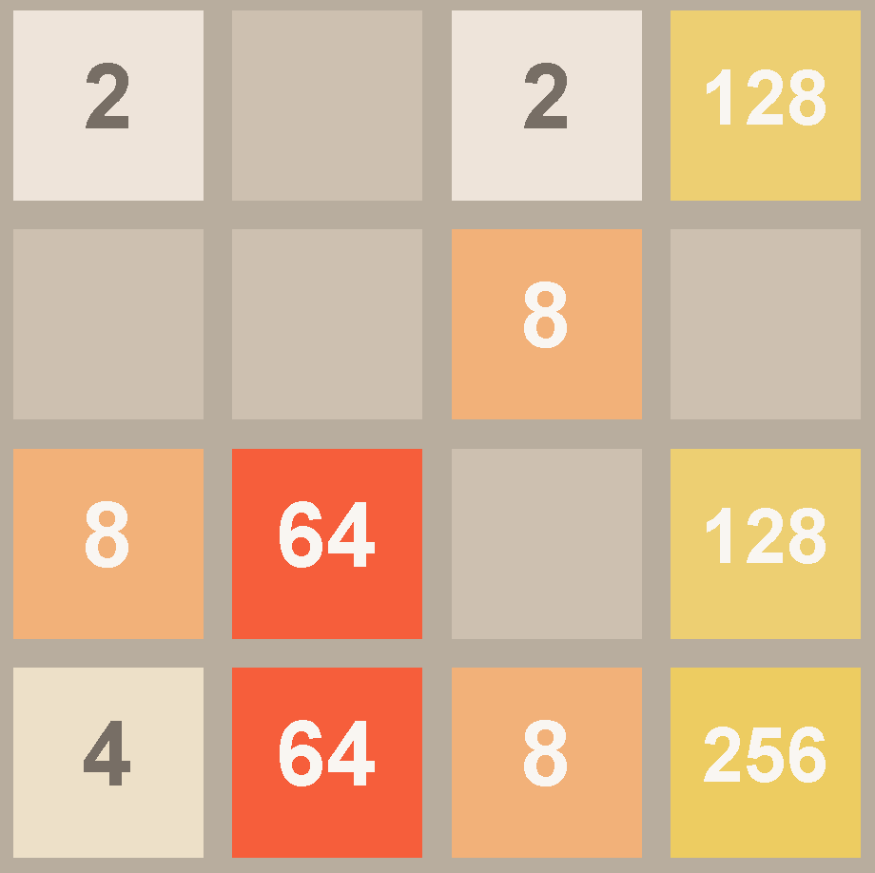
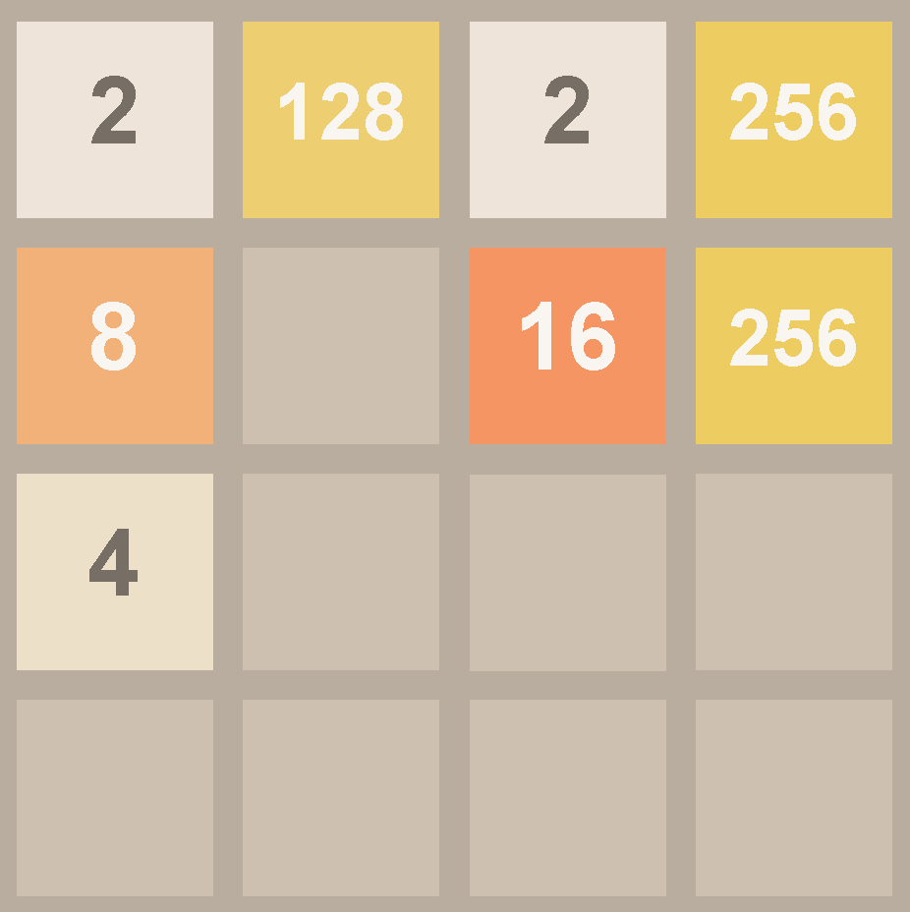
Example of a Complex Task from Project 0
In Project 0, you’ll implement a “tilt” function for the game 2048. A lot happens at once. Absolutely vital to decompose the problem into pieces.
Example: Can do tilt(NORTH) by creating tiltColumn and calling 4x.
Example: Can do tiltColumn by decomposing into more helper function(s).
tilt(NORTH)

Slide 43
Goal: Larger Than Four Neighbors
Classes in Java
Defining and Instantiating Classes
Class Terminology
Static vs. Instance Members
Practice Question
Helper Methods
Managing Complexity with Helper Methods
Goal: Larger Than Four Neighbors
Coding Without Helper Methods
Coding With Helper Methods
Lecture 2, CS61B, Fall 2023

Slide 44
Goal: largerThanFourNeighbors
Suppose we want to write a method:
This method will return a new array that contains every Dog that is larger than its 4 closest neighbors, i.e. the two on the left and the two in the right.
If there are not enough neighbors, i.e. you’re at the end of the array, then consider just the neighbors that exist.
For example:
Input: Dogs with size [10, 20, 30, 25, 20, 40, 10]
Returns: Dogs with size [30, 40].
30 is greater than 10, 20, 25, and 20.
40 is greater than 25, 20, and 10.
public static Dog[] largerThanFourNeighbors(Dog[] dogs)

Slide 45
Goal: largerThanFourNeighbors
Suppose we want to write a method:
If input Dog sizes are [10, 15, 20, 15, 10, 5, 10, 15, 22, 20], what will be the size of the Dogs returned?
[20]
[20, 22]
[20, 22, 20]
public static Dog[] largerThanFourNeighbors(Dog[] dogs)

Slide 46
Goal: largerThanFourNeighbors
Suppose we want to write a method:
If input Dog sizes are [10, 15, 20, 15, 10, 5, 10, 15, 22, 20], what will be the size of the Dogs returned?
[20]
[20, 22]
[20, 22, 20]
public static Dog[] largerThanFourNeighbors(Dog[] dogs)

Slide 47
Coding Without Helper Methods
Classes in Java
Defining and Instantiating Classes
Class Terminology
Static vs. Instance Members
Practice Question
Helper Methods
Managing Complexity with Helper Methods
Goal: Larger Than Four Neighbors
Coding Without Helper Methods
Coding With Helper Methods
Lecture 2, CS61B, Fall 2023

Slide 48
Writing largerThanFourNeighbors
Now let’s try it out!
Let’s make an attempt during lecture that will be all part of one big method (i.e. there are no helper methods!).
This code will be messy, hard to reason about, hard to debug.

Slide 49
Starter Code for Dog Problem
DogProblem.java
public class DogProblem {
public static Dog[] largerThanFourNeighbors(Dog[] dogs) {
return dogs; // replace this with your solution
}
public static void main(String[] args) {
Dog[] dogs = new Dog[]{
new Dog(10), new Dog(15),
new Dog(20), new Dog(15),
new Dog(10), new Dog(5),
new Dog(10), new Dog(15),
new Dog(22), new Dog(15),
new Dog(20)
};
Dog[] bigDogs1 = largerThanFourNeighbors(dogs);
/** When you run this program you should get "20 22" */
for (int k = 0; k < bigDogs1.length; k += 1) {
if (bigDogs1[k] != null) {
System.out.print(bigDogs1[k].weightInPounds + " ");
}
}
System.out.println();
}
}

Slide 50
Coding Demo: largerThanFourNeighbors (no helper methods)
DogProblem.java
public class DogProblem {
public static Dog[] largerThanFourNeighbors(Dog[] dogs) {
return dogs;
}
}

Slide 51
Coding Demo: largerThanFourNeighbors (no helper methods)
DogProblem.java
public class DogProblem {
public static Dog[] largerThanFourNeighbors(Dog[] dogs) {
for (int i = 0; i < dogs.length; i += 1) {
}
}
}

Slide 52
Coding Demo: largerThanFourNeighbors (no helper methods)
DogProblem.java
public class DogProblem {
public static Dog[] largerThanFourNeighbors(Dog[] dogs) {
for (int i = 0; i < dogs.length; i += 1) {
for (int j = -2; j <= 2; j += 1) {
Dog neighborDog = dogs[i + j];
}
}
}
}

Slide 53
Coding Demo: largerThanFourNeighbors (no helper methods)
DogProblem.java
public class DogProblem {
public static Dog[] largerThanFourNeighbors(Dog[] dogs) {
for (int i = 0; i < dogs.length; i += 1) {
for (int j = -2; j <= 2; j += 1) {
if (i + j < 0) {
continue;
}
Dog neighborDog = dogs[i + j];
}
}
}
}

Slide 54
Coding Demo: largerThanFourNeighbors (no helper methods)
DogProblem.java
public class DogProblem {
public static Dog[] largerThanFourNeighbors(Dog[] dogs) {
for (int i = 0; i < dogs.length; i += 1) {
for (int j = -2; j <= 2; j += 1) {
if (i + j < 0) {
continue;
}
if (i + j >= dogs.length) {
break;
}
Dog neighborDog = dogs[i + j];
}
}
}
}

Slide 55
Coding Demo: largerThanFourNeighbors (no helper methods)
DogProblem.java
public class DogProblem {
public static Dog[] largerThanFourNeighbors(Dog[] dogs) {
for (int i = 0; i < dogs.length; i += 1) {
boolean largest = true;
for (int j = -2; j <= 2; j += 1) {
if (i + j < 0) {
continue;
}
if (i + j >= dogs.length) {
break;
}
Dog neighborDog = dogs[i + j];
}
}
}
}

Slide 56
Coding Demo: largerThanFourNeighbors (no helper methods)
DogProblem.java
public class DogProblem {
public static Dog[] largerThanFourNeighbors(Dog[] dogs) {
for (int i = 0; i < dogs.length; i += 1) {
boolean largest = true;
for (int j = -2; j <= 2; j += 1) {
if (i + j < 0) {
continue;
}
if (i + j >= dogs.length) {
break;
}
Dog neighborDog = dogs[i + j];
if (neighborDog.weightInPounds >= dogs[i].weightInPounds) {
largest = false;
}
}
}
}
}

Slide 57
Coding Demo: largerThanFourNeighbors (no helper methods)
DogProblem.java
public class DogProblem {
public static Dog[] largerThanFourNeighbors(Dog[] dogs) {
for (int i = 0; i < dogs.length; i += 1) {
boolean largest = true;
for (int j = -2; j <= 2; j += 1) {
if (i + j < 0 || j == 0) {
continue;
}
if (i + j >= dogs.length) {
break;
}
Dog neighborDog = dogs[i + j];
if (neighborDog.weightInPounds >= dogs[i].weightInPounds) {
largest = false;
}
}
}
}
}

Slide 58
Coding With Helper Methods
Classes in Java
Defining and Instantiating Classes
Class Terminology
Static vs. Instance Members
Practice Question
Helper Methods
Managing Complexity with Helper Methods
Goal: Larger Than Four Neighbors
Coding Without Helper Methods
Coding With Helper Methods
Lecture 2, CS61B, Fall 2023

Slide 59
Doing a Better Job
Now that you understand the problem, you might try coming up with a better solution.
Starter code on the next slide (copy and paste into IntelliJ).
By formally decomposing into helper methods, our code will be easier to read and understand, and easier to debug when things go wrong.
Or if you’d prefer, a solution available in this supplementary video:
https://www.youtube.com/watch?v=23gXoMFRY9Q&list=PL8FaHk7qbOD5Q4GloF2DHaancV6BOJzL0&index=11

Slide 60
Coding Demo: largerThanFourNeighbors (with helper methods)
DogProblem.java
public class DogProblem {
public static Dog[] largerThanFourNeighbors(Dog[] dogs) {
return dogs;
}
}

Slide 61
Coding Demo: largerThanFourNeighbors (with helper methods)
DogProblem.java
public class DogProblem {
public static Dog[] largerThanFourNeighbors(Dog[] dogs) {
for (int i = 0; i < dogs.length; i += 1) {
}
}
}

Slide 62
Coding Demo: largerThanFourNeighbors (with helper methods)
DogProblem.java
public class DogProblem {
public static Dog[] largerThanFourNeighbors(Dog[] dogs) {
for (int i = 0; i < dogs.length; i += 1) {
if (isBiggestOfFour(dogs, i)) {
}
}
}
}

Slide 63
Coding Demo: largerThanFourNeighbors (with helper methods)
DogProblem.java
public class DogProblem {
/** Returns true if dogs[i] is larger than its four neighbors */
public static boolean isBiggestOfFour(Dog[] dogs, int i) {
}
}

Slide 64
Coding Demo: largerThanFourNeighbors (with helper methods)
DogProblem.java
public class DogProblem {
public static Dog[] largerThanFourNeighbors(Dog[] dogs) {
for (int i = 0; i < dogs.length; i += 1) {
if (isBiggestOfFour(dogs, i)) {
}
}
}
}

Slide 65
Coding Demo: largerThanFourNeighbors (with helper methods)
DogProblem.java
public class DogProblem {
public static Dog[] largerThanFourNeighbors(Dog[] dogs) {
Dog[] returnDogs = new Dog[dogs.length];
int cnt = 0;
for (int i = 0; i < dogs.length; i += 1) {
if (isBiggestOfFour(dogs, i)) {
}
}
}
}

Slide 66
Coding Demo: largerThanFourNeighbors (with helper methods)
DogProblem.java
public class DogProblem {
public static Dog[] largerThanFourNeighbors(Dog[] dogs) {
Dog[] returnDogs = new Dog[dogs.length];
int cnt = 0;
for (int i = 0; i < dogs.length; i += 1) {
if (isBiggestOfFour(dogs, i)) {
returnDogs[cnt] = dogs[i];
cnt = cnt + 1;
}
}
}
}

Slide 67
Coding Demo: largerThanFourNeighbors (with helper methods)
DogProblem.java
public class DogProblem {
public static Dog[] largerThanFourNeighbors(Dog[] dogs) {
Dog[] returnDogs = new Dog[dogs.length];
int cnt = 0;
for (int i = 0; i < dogs.length; i += 1) {
if (isBiggestOfFour(dogs, i)) {
returnDogs[cnt] = dogs[i];
cnt = cnt + 1;
}
}
return returnDogs;
}
}

Slide 68
Coding Demo: largerThanFourNeighbors (with helper methods)
DogProblem.java
public class DogProblem {
/** Returns true if dogs[i] is larger than its four neighbors */
public static boolean isBiggestOfFour(Dog[] dogs, int i) {
}
}

Slide 69
Coding Demo: largerThanFourNeighbors (with helper methods)
DogProblem.java
public class DogProblem {
/** Returns true if dogs[i] is larger than its four neighbors */
public static boolean isBiggestOfFour(Dog[] dogs, int i) {
for (int j = -2; j <= 2; j += 1) {
}
}
}

Slide 70
Coding Demo: largerThanFourNeighbors (with helper methods)
DogProblem.java
public class DogProblem {
/** Returns true if dogs[i] is larger than its four neighbors */
public static boolean isBiggestOfFour(Dog[] dogs, int i) {
boolean isBiggest = true;
for (int j = -2; j <= 2; j += 1) {
}
}
}

Slide 71
Coding Demo: largerThanFourNeighbors (with helper methods)
DogProblem.java
public class DogProblem {
/** Returns true if dogs[i] is larger than its four neighbors */
public static boolean isBiggestOfFour(Dog[] dogs, int i) {
boolean isBiggest = true;
for (int j = -2; j <= 2; j += 1) {
}
}
public static boolean validIndex(Dog[] dogs, int i) {
}
}

Slide 72
Coding Demo: largerThanFourNeighbors (with helper methods)
DogProblem.java
public class DogProblem {
/** Returns true if dogs[i] is larger than its four neighbors */
public static boolean isBiggestOfFour(Dog[] dogs, int i) {
boolean isBiggest = true;
for (int j = -2; j <= 2; j += 1) {
}
}
public static boolean validIndex(Dog[] dogs, int i) {
return (i >= 0) && (i < dogs.length);
}
}

Slide 73
Coding Demo: largerThanFourNeighbors (with helper methods)
DogProblem.java
public class DogProblem {
/** Returns true if dogs[i] is larger than its four neighbors */
public static boolean isBiggestOfFour(Dog[] dogs, int i) {
boolean isBiggest = true;
for (int j = -2; j <= 2; j += 1) {
int compareIndex = i + j;
}
}
public static boolean validIndex(Dog[] dogs, int i) {
return (i >= 0) && (i < dogs.length);
}
}

Slide 74
Coding Demo: largerThanFourNeighbors (with helper methods)
DogProblem.java
public class DogProblem {
/** Returns true if dogs[i] is larger than its four neighbors */
public static boolean isBiggestOfFour(Dog[] dogs, int i) {
boolean isBiggest = true;
for (int j = -2; j <= 2; j += 1) {
int compareIndex = i + j;
if (validIndex(dogs, compareIndex)) {
}
}
}
public static boolean validIndex(Dog[] dogs, int i) {
return (i >= 0) && (i < dogs.length);
}
}

Slide 75
Coding Demo: largerThanFourNeighbors (with helper methods)
DogProblem.java
public class DogProblem {
/** Returns true if dogs[i] is larger than its four neighbors */
public static boolean isBiggestOfFour(Dog[] dogs, int i) {
boolean isBiggest = true;
for (int j = -2; j <= 2; j += 1) {
int compareIndex = i + j;
if (validIndex(dogs, compareIndex)) {
if(dogs[compareIndex].weightInPounds >= dogs[i].weightInPounds) {
isBiggest = false;
}
}
}
}
public static boolean validIndex(Dog[] dogs, int i) {
return (i >= 0) && (i < dogs.length);
}
}

Slide 76
Coding Demo: largerThanFourNeighbors (with helper methods)
DogProblem.java
public class DogProblem {
/** Returns true if dogs[i] is larger than its four neighbors */
public static boolean isBiggestOfFour(Dog[] dogs, int i) {
boolean isBiggest = true;
for (int j = -2; j <= 2; j += 1) {
int compareIndex = i + j;
if (validIndex(dogs, compareIndex)) {
if(dogs[compareIndex].weightInPounds >= dogs[i].weightInPounds) {
isBiggest = false;
}
}
}
return isBiggest;
}
public static boolean validIndex(Dog[] dogs, int i) {
return (i >= 0) && (i < dogs.length);
}
}

Slide 77
Coding Demo: largerThanFourNeighbors (with helper methods)
DogProblem.java
public class DogProblem {
/** Returns true if dogs[i] is larger than its four neighbors */
public static boolean isBiggestOfFour(Dog[] dogs, int i) {
boolean isBiggest = true;
for (int j = -2; j <= 2; j += 1) {
int compareIndex = i + j;
if (validIndex(dogs, compareIndex) && j != 0) {
if(dogs[compareIndex].weightInPounds >= dogs[i].weightInPounds) {
isBiggest = false;
}
}
}
return isBiggest;
}
public static boolean validIndex(Dog[] dogs, int i) {
return (i >= 0) && (i < dogs.length);
}
}

